Slide 1

Facebook political ads
By Doug Torres
Data Analytics Cohort 1

Slide 2
motivation
Social media has influenced how the political discourse takes place and which information is advertised en masse.
Facebook is the largest platform for political ads so I will be looking into who is paying for these and how they decide to target people on the platform.
It was discovered in 2017 that Cambridge Analytica used information from 50 million accounts.

Slide 3
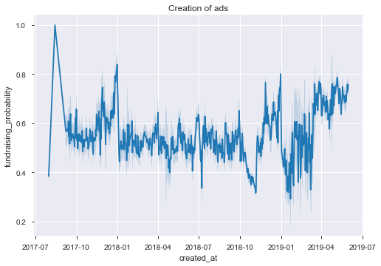
Setting the stage
The creation of ads follows the political campaigns as shown by the dropoff after the 2018 midterm elections and a ramp up for the 2020 presidential campaigns.

Slide 4
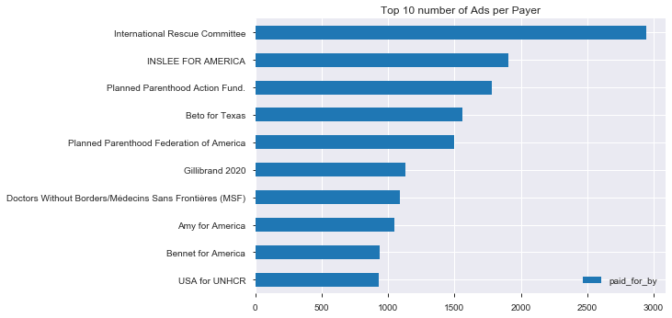
Who are the payers?
Payers who paid for the most ads on the platform.
Beto is a recurring top performer as far as presence on Facebook

Slide 5
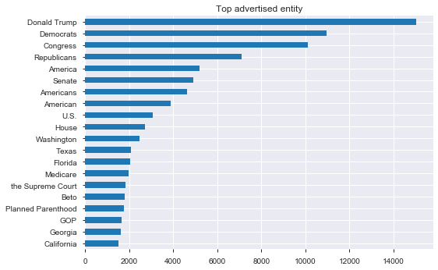
Who/what is getting the most attention?
Donald Trump and Beto O’Rourke where the most advertised individuals.
All other entities where groups/organizations.

Slide 6
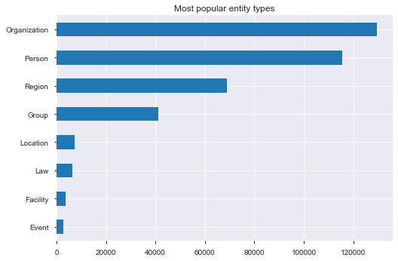
Orgs and People are the most advertised

Slide 7
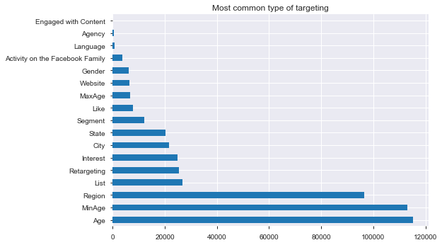
Most common targets
Age
Region
Interests

Slide 8
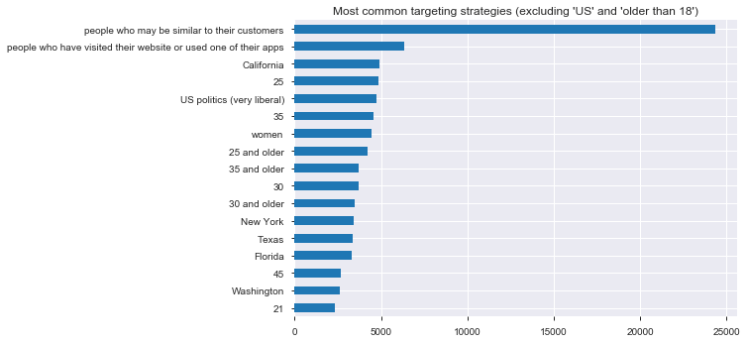
How are advertisers getting to you?
Excluding “18 or older” and “living in the US” targets, these are the most used ways to pinpoint the audience.

Slide 9
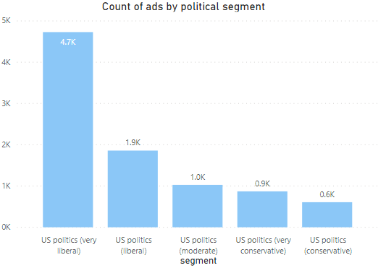
What are their politics?
Number of ads

Slide 10
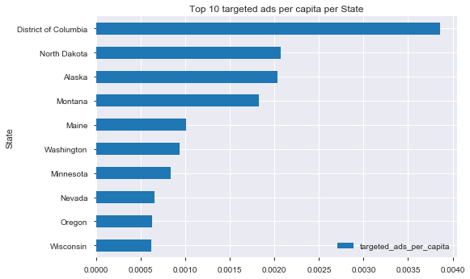
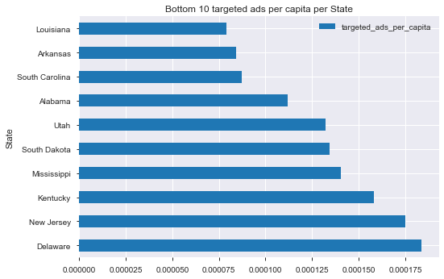
Which states get targeted the most?

Slide 11

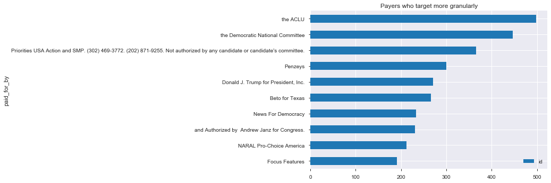
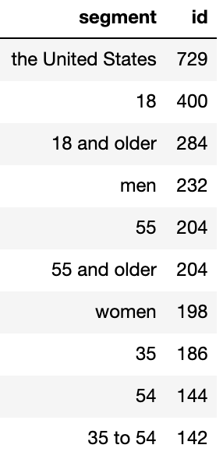
Who wants you more specifically?

Slide 12
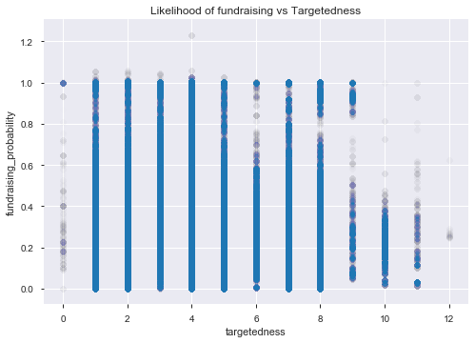
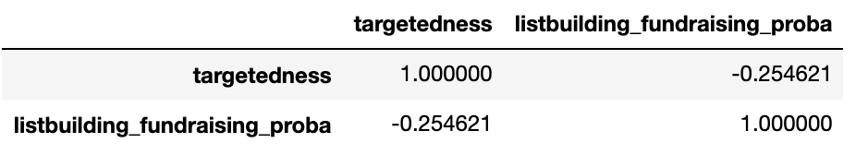
How do they raise the most money?
Data shows a decline in fundraising probability as the ads get more granular.

Slide 13
Power bi dashboard
https://app.powerbi.com/groups/me/reports/a61660ce-974d-45a5-b2a0-2b6fbd7307c8/ReportSection

Slide 14
Sources
The guardian: 'It might work too well': the dark art of political advertising online https://www.theguardian.com/technology/2018/mar/19/facebook-political-ads-social-media-history-online-democracy
Facebook political ads database: https://www.propublica.org/datastore/dataset/political-advertisements-from-facebook
Data is plural: https://tinyletter.com/data-is-plural/letters/data-is-plural-2016-11-16-edition

